Slide 1
Unsupervised learning

Slide 2
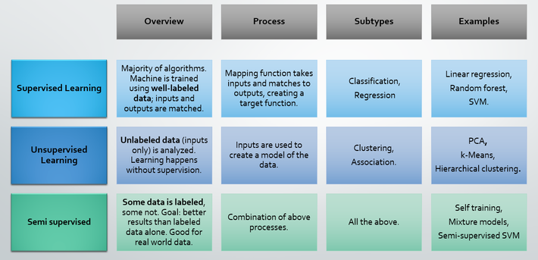
Introduction

Slide 3
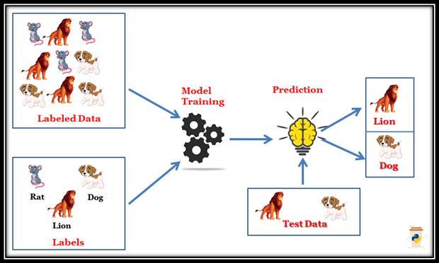
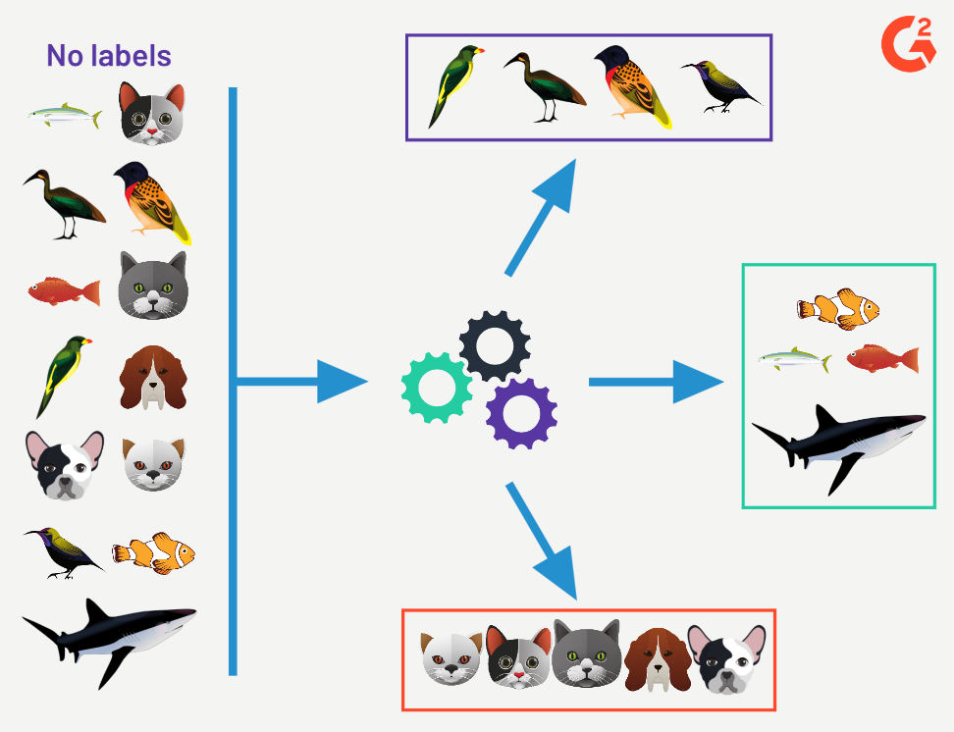
Supervised learning vs. unsupervised learning
Supervised learning: discover patterns in the data that relate data attributes with a target (class) attribute.
These patterns are then utilized to predict the values of the target attribute in future data instances.
Unsupervised learning: The data have no target attribute.
We want to explore the data to find some intrinsic structures in them.

Slide 4
Supervised Learning

Slide 5
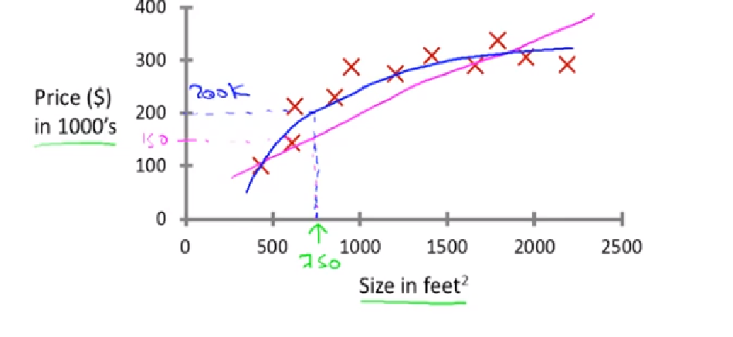

Slide 6
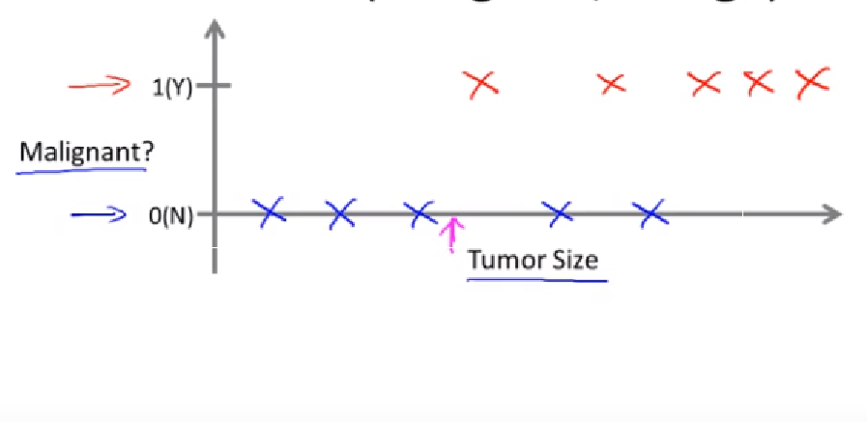
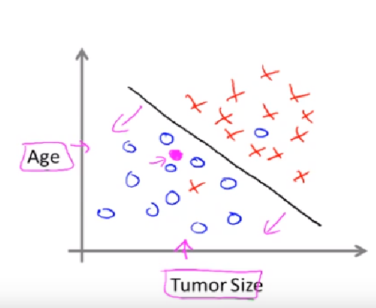
Machine Learning Specialization by Andrew Ng

Slide 7
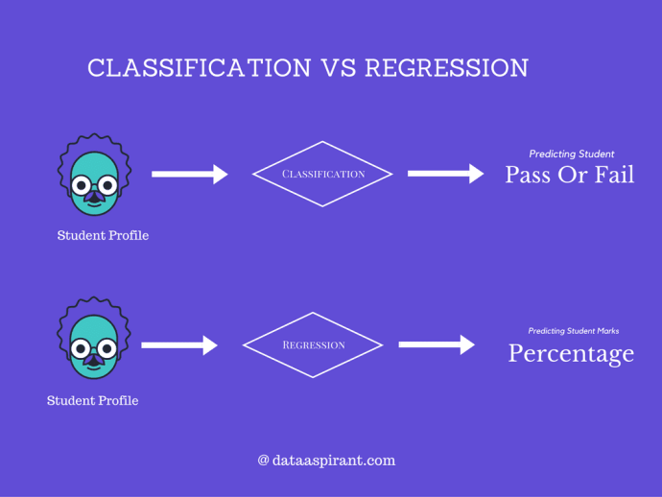
Regression: outcome is numerical, prediction of continuous valued output
Classification : Outcome is a category

Slide 8
Classification
Classification is the task of generalizing known structure to apply to new data.
Common algorithms include decision tree learning, naïve Bayesian classification, neural networks, support vector machine and nearest neighbor .
Ex: a classification method may attempt to classify the given text as hatespeech or normal speech

Slide 9
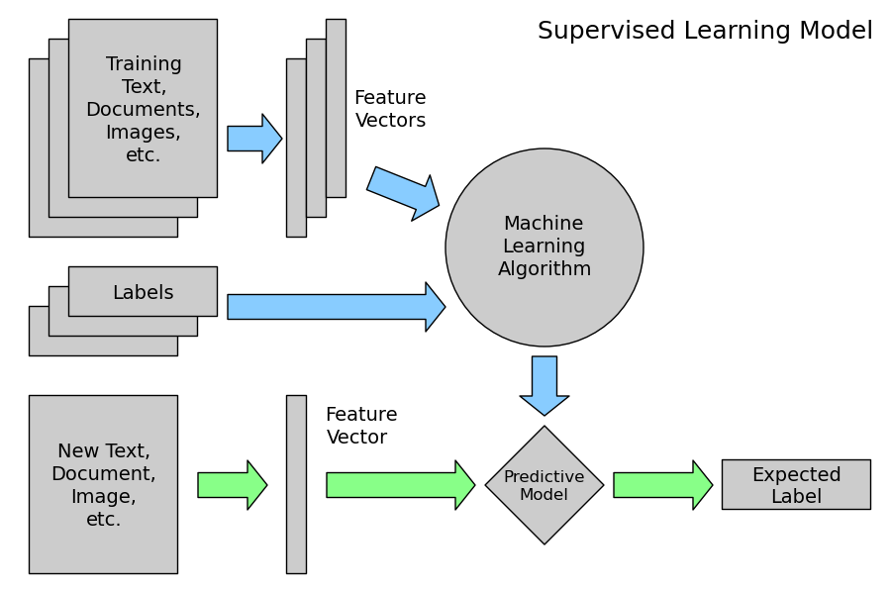
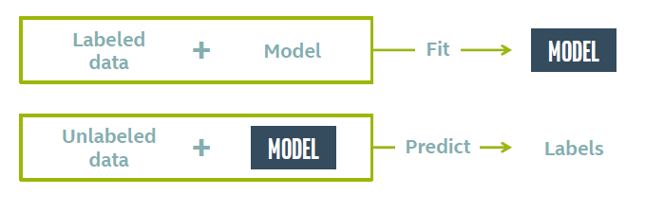

Slide 10
Regression
Regression attempts to find a function which models the data with the least error.
Examples:
Predicting wind velocity as a function of temperature, humidity, air pressure etc.
Predicting sales amount of new product based on advertising expenditure.

Slide 11
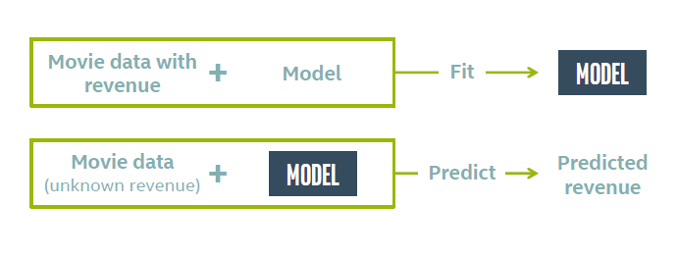
Regression

Slide 12
You’re running a company, and you want to develop learning algorithms to address each of two problems.
Problem 1: You have a data for sale of shampoo bottles over 100 months of of time. You want to predict how many of the bottles will sell over the next 3 months.
Problem 2: You’d like software to examine individual customer accounts, and for each account decide if it has been hacked/compromised.
Should you treat these as classification or as regression problems?
1. Treat both as classification problems.
2. Treat problem 1 as a classification problem, problem 2 as a regression problem.
3. Treat problem 1 as a regression problem, problem 2 as a classification problem.
4. Treat both as regression problems.

Slide 13
Supervised learning categories & techniques
Linear classifier (numerical functions)
Parametric (Probabilistic functions) : Naïve Bayes, Gaussian discriminant analysis (GDA), Hidden Markov models (HMM), Probabilistic graphical models
Non-parametric (Instance-based functions): K-nearest neighbors, Kernel regression, Kernel density estimation, Local regression
Non-metric (Symbolic functions) : Classification and regression tree (CART), decision tree
Aggregation: Bagging (bootstrap + aggregation), Adaboost, Random forest

Slide 14
Unsupervised Learning

Slide 15
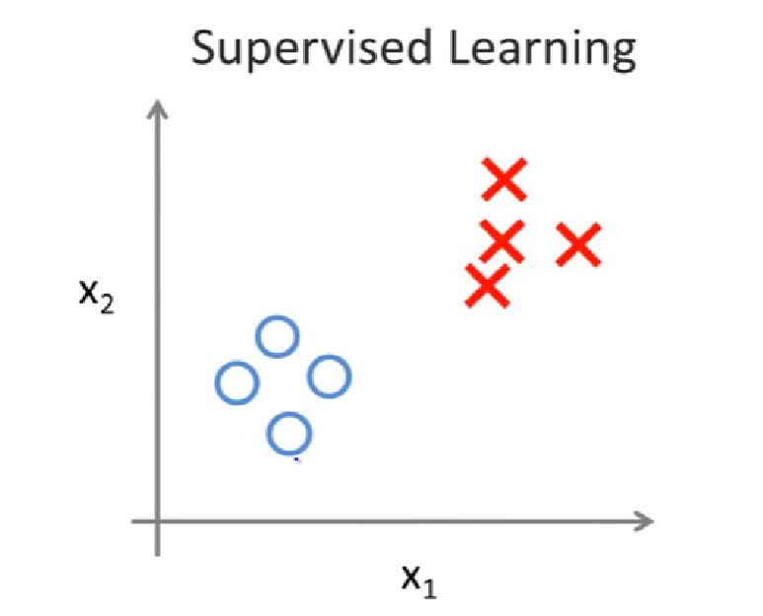
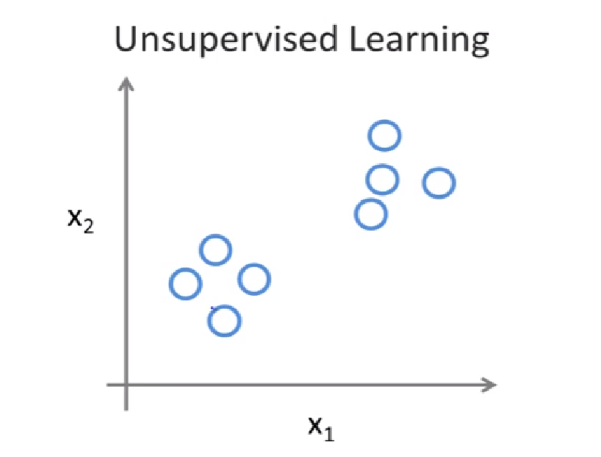
Supervised Vs Unsupervised
Machine Learning Specialization by Andrew Ng

Slide 16
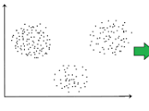
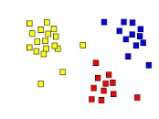
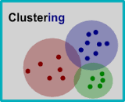
Clustering
Clustering is the task of dividing the population or data points into a number of groups such that data points in the same groups are more similar to other data points in the same group than those in other groups. In simple words, the aim is to segregate groups with similar traits and assign them into clusters.

Slide 17
Of the following examples, which would you address using an
unsupervised learning algorithm?
1. Given email labeled as spam/not spam, learn a spam filter.
2. Given a set of news articles found on the web, group them into set of articles about the same story.
3. Given a database of customer data, automatically discover market segments and group customers into different market segments.
4. Given a dataset of patients diagnosed as either having diabetes or not, learn to classify new patients as having diabetes or not.

Slide 18
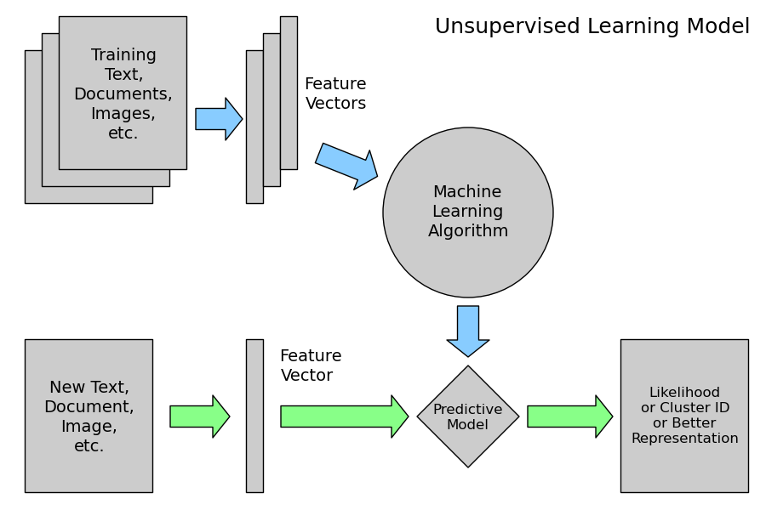

Slide 19
Clustering
Go to www.news.google.com

Slide 20
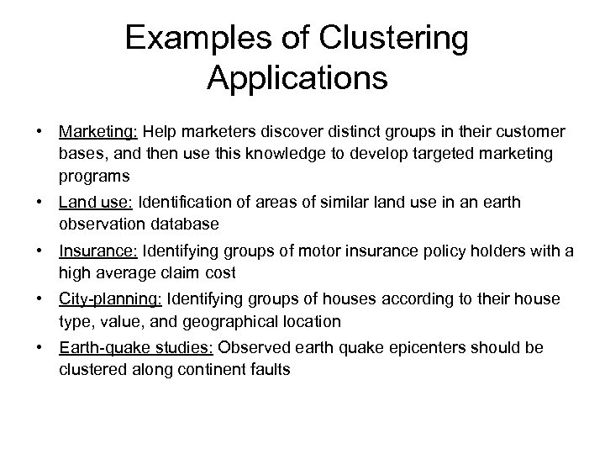

Slide 21
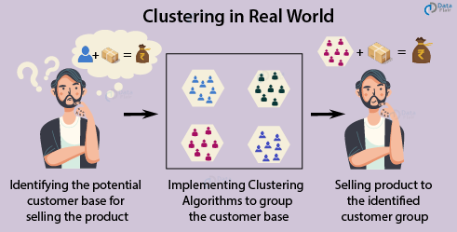

Slide 22
Introduction to Clustering

Slide 23
What is clustering?
Ch. 16
The process of grouping a set of objects into classes of similar objects
Documents within a cluster should be similar.
Documents from different clusters should be dissimilar.
The commonest form of unsupervised learning
Unsupervised learning = learning from raw data, as opposed to supervised data where a classification of examples is given
A common and important task that finds many applications in IR and other places
Clustering is a technique for finding similarity groups in data, called clusters. i.e.,
it groups data instances that are similar to (near) each other in one cluster and data instances that are very different (far away) from each other into different clusters.
Clustering is often called an unsupervised learning task as no class values denoting an a priori grouping of the data instances are given, which is the case in supervised learning.
Due to historical reasons, clustering is often considered synonymous with unsupervised learning.

Slide 24
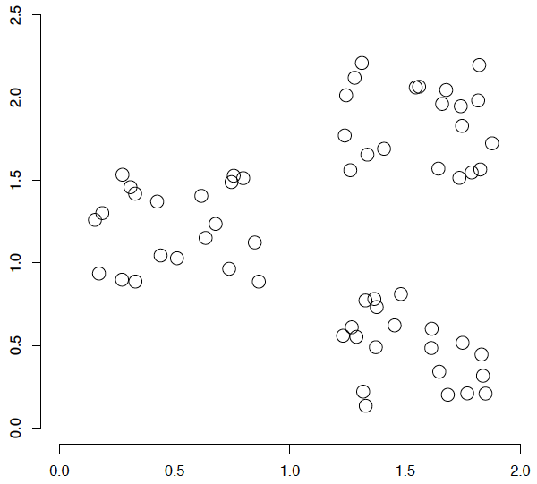
A data set with clear cluster structure
Ch. 16
How would you design an algorithm for finding the three clusters in this case?

Slide 25
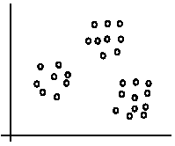
An illustration
The data set has three natural groups of data points, i.e., 3 natural clusters.

Slide 26
What is clustering for?
Let us see some real-life examples
Example 1: groups people of similar sizes together to make “small”, “medium” and “large” T-Shirts.
Tailor-made for each person: too expensive
One-size-fits-all: does not fit all.
Example 2: In marketing, segment customers according to their similarities
To do targeted marketing.

Slide 27
What is clustering for? (cont…)
Example 3: Given a collection of text documents, we want to organize them according to their content similarities,
To produce a topic hierarchy
Example 4: Identify similar energy use customer profiles
<x> = time series of energy usage
Example 5: Identify anomalies in user behavior for computer security
<x> = sequences of user commands
In fact, clustering is one of the most utilized data mining techniques.
It has a long history, and used in almost every field, e.g., medicine, psychology, botany, sociology, biology, archeology, marketing, insurance, libraries, etc.
In recent years, due to the rapid increase of online documents, text clustering has become important.

Slide 28
Clustering (Unsupervised Learning)
< x , x , … x >
Given: Examples:
Find: A natural clustering (grouping) of the data
Example Applications:
Identify similar energy use customer profiles
<x> = time series of energy usage
Identify anomalies in user behavior for computer security
<x> = sequences of user commands
1
2
n
n
Notes:
When we don’t have labels (I.e., f) we have an unsupervised learning problem.
We can apply clustering to
Find the prototypes in our data – for example to find similar customers
Find the large groups of similar observations to identify deviations/anomalies/outliers.

Slide 29
Why cluster?
Labeling is expensive
Gain insight into the structure of the data
Find prototypes in the data
Notes:
Until now we have assumed that the training data is labeled.
Now we look at what can we do with data when we have not labels.
\item Example: group customer behavior, find similar buying patterns.

Slide 30
Aspects of clustering
A clustering algorithm
Partitional clustering
Hierarchical clustering
…
A distance (similarity, or dissimilarity) function

Slide 31
Aspects of Clustering
Inter-cluster distance is the distance between the data items in distinct clusters.
Intra-cluster distance is the distance among members of a cluster, rather than the distance between two different clusters. This metric gives a sense of how well the distance measure was able to bring the items together.
Clustering quality
Inter-clusters distance ⇒ maximized
Intra-clusters distance ⇒ minimized
The quality of a clustering result depends on the algorithm, the distance function, and the application

Slide 32
Goal of Clustering
Given a set of data points, each described by a set of attributes, find clusters such that:
Inter-cluster similarity is
maximized
Intra-cluster similarity is
minimized
Requires the definition of a similarity measure
F1
x
x
x
x
x
x
x
x
xx
x
x
x
x
x
x
xx
x
F2
Notes:
Data

Slide 33









What is a natural grouping of these objects?

Slide 34



What is a natural grouping of these objects?
Slide from Eamonn Keogh
Clustering is subjective
Simpson's Family
School Employees
Females
Males

Slide 35
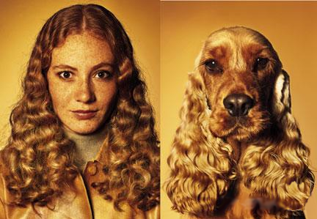
What is Similarity?
Similarity is hard to define, but…
“We know it when we see it”

Slide 36
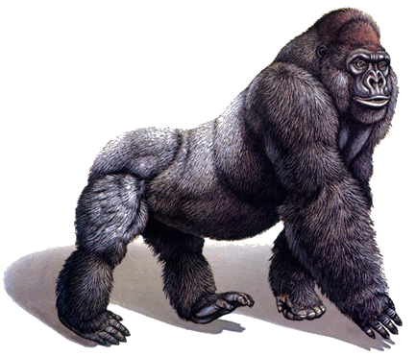
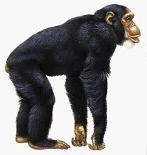
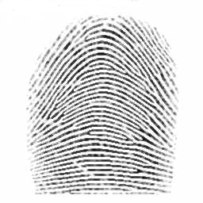
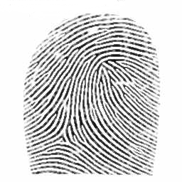
Defining Distance Measures
Slide from Eamonn Keogh
Definition: Let O₁ and O₂ be two objects from the universe of possible objects. The distance (dissimilarity) between O₁ and O₂ is a real number denoted by D(O₁,O₂)
Peter
Piotr
0.23
3
342.7

Slide 37
Slide based on one by Eamonn Keogh
What properties should a distance measure have?
D(A,B) = D(B,A) Symmetry
D(A,A) = 0 Constancy of Self-Similarity
D(A,B) = 0 iif A= B Positivity (Separation)
D(A,B) ≤ D(A,C) + D(B,C) Triangular Inequality

Slide 38
Slide based on one by Eamonn Keogh
Intuitions behind desirable distance measure properties
D(A,B) = D(B,A)
Otherwise you could claim “Alex looks like Bob, but Bob looks nothing like Alex.”
D(A,A) = 0
Otherwise you could claim “Alex looks more like Bob, than Bob does.”

Slide 39
Slide based on one by Eamonn Keogh
Intuitions behind desirable distance measure properties (continued)
D(A,B) = 0 IIf A=B
Otherwise there are objects in your world that are different, but you cannot tell apart.
D(A,B) ≤ D(A,C) + D(B,C)
Otherwise you could claim “Alex is very like Bob, and Alex is very like Carl, but Bob is very unlike Carl.”

Slide 40
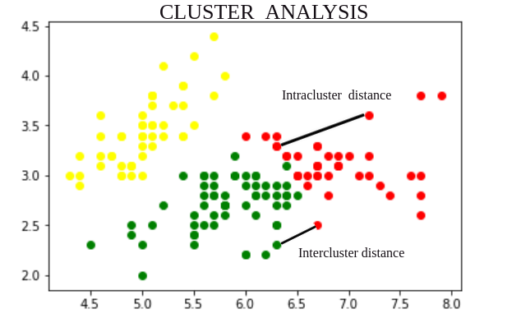
Cluster Analysis – The aim of the clustering process is to discover overall distribution patterns and interesting correlations among the data attributes. It is the task of grouping a set of objects in such a way that objects in the same group are more similar to each other than to those in other groups. Cluster analysis itself is not one specific algorithm, but the general task to be solved. It can be achieved by various algorithms that differ significantly in their understanding of what constitutes a cluster and how to efficiently find them. Popular notions of clusters include groups with small distances between cluster members, dense areas of the data space, intervals or particular statistical distributions.
Here, we will discuss about the distance between the objects of the different clusters and the objects of the same clusters. We have two type of distance – Intercluster Distance and Intracluster Distance.

Slide 41
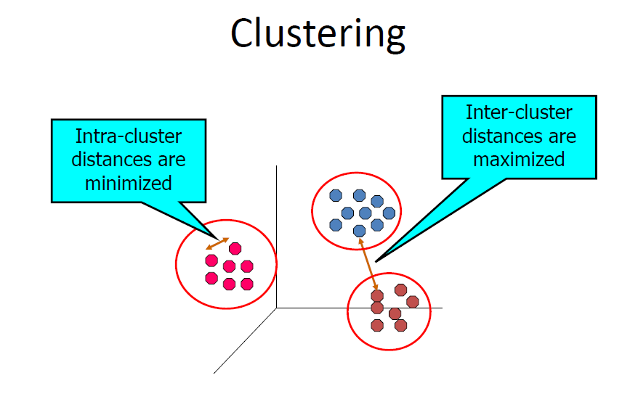
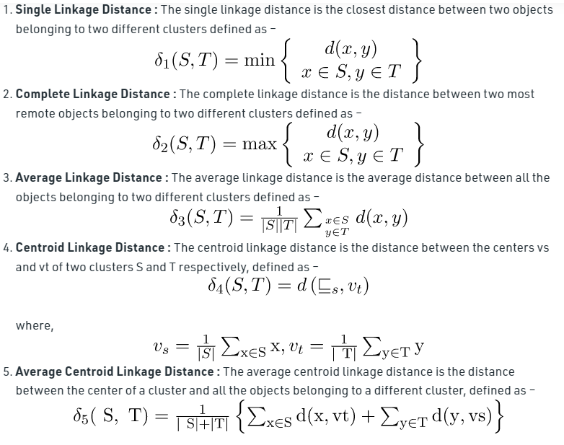
Let S and T are clusters formed
using partition U. d(x, y) is the distance between two objects x and y belonging to S and T respectively.
d(x, y) is calculated using well-known distance calculating methods such as Euclidean, Manhattan and
Chebychev. |S| and |T| are the number of objects in clusters S and T respectively.

Slide 42
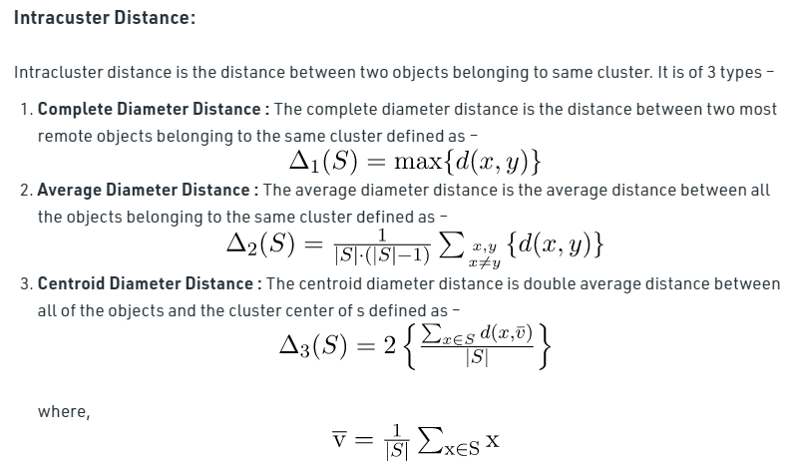

Slide 43
Distance measures play an important role in machine learning.
A distance measure is an objective score that summarizes the relative difference between two objects in a problem domain.
Most commonly, the two objects are rows of data that describe a subject (such as a person, car, or house), or an event (such as a purchase, a claim, or a diagnosis).
When calculating the distance between two examples or rows of data, it is possible that different data types are used for different columns of the examples. An example might have real values, boolean values, categorical values, and ordinal values. Different distance measures may be required for each that are summed together into a single distance score.
Numerical values may have different scales. This can greatly impact the calculation of distance measure and it is often a good practice to normalize or standardize numerical values prior to calculating the distance measure.

Slide 44
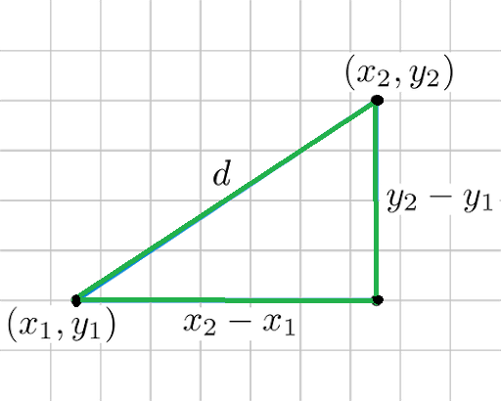
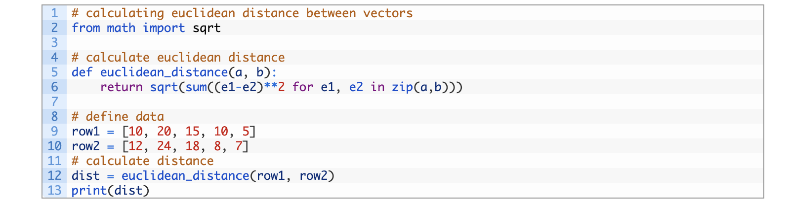
Euclidean Distance:
Euclidean distance is considered the traditional metric for problems with geometry. It can be simply explained as the ordinary distance between two points. It is one of the most used algorithms in the cluster analysis. One of the algorithms that use this formula would be K-mean. Mathematically it computes the root of squared differences between the coordinates between two objects.
Answer : 6.0827

Slide 45
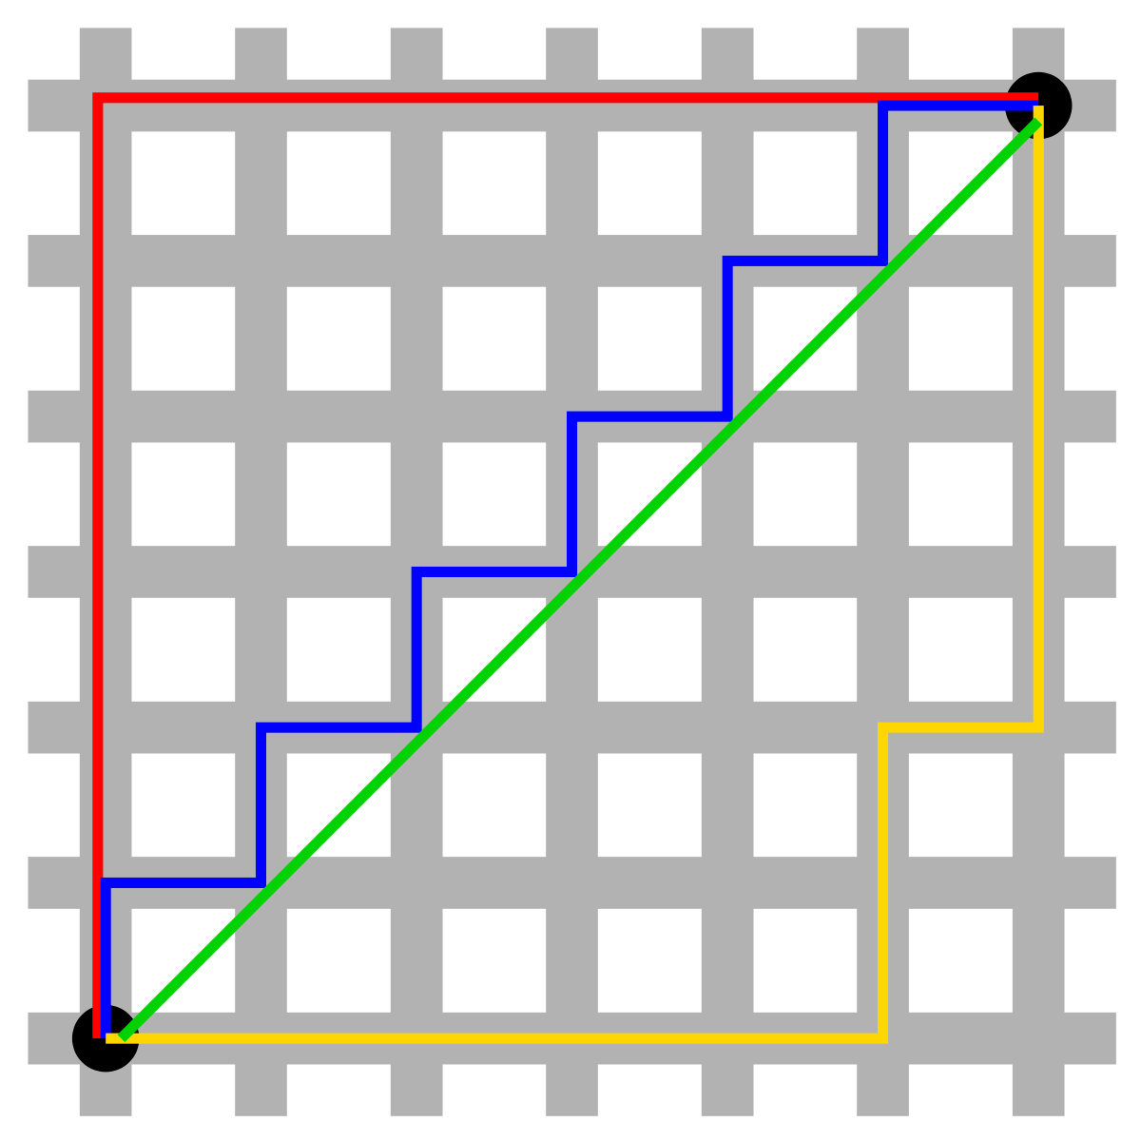
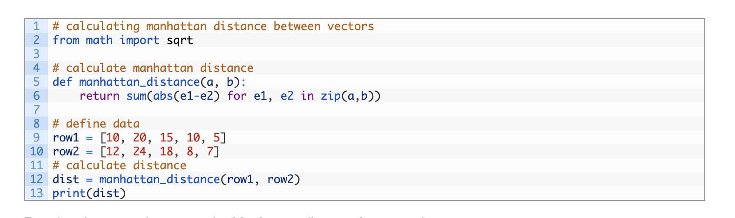
2. Manhattan Distance:
This determines the absolute difference among the pair of the coordinates. Suppose we have two points P and Q to determine the distance between these points we simply have to calculate the perpendicular distance of the points from X-Axis and Y-Axis. In a plane with P at coordinate (x1, y1) and Q at (x2, y2).
Manhattan distance between P and Q = |x1 – x2| + |y1 – y2|
Here the total distance of the Red line gives the Manhattan distance between both the points.
Answer : 13

Slide 46
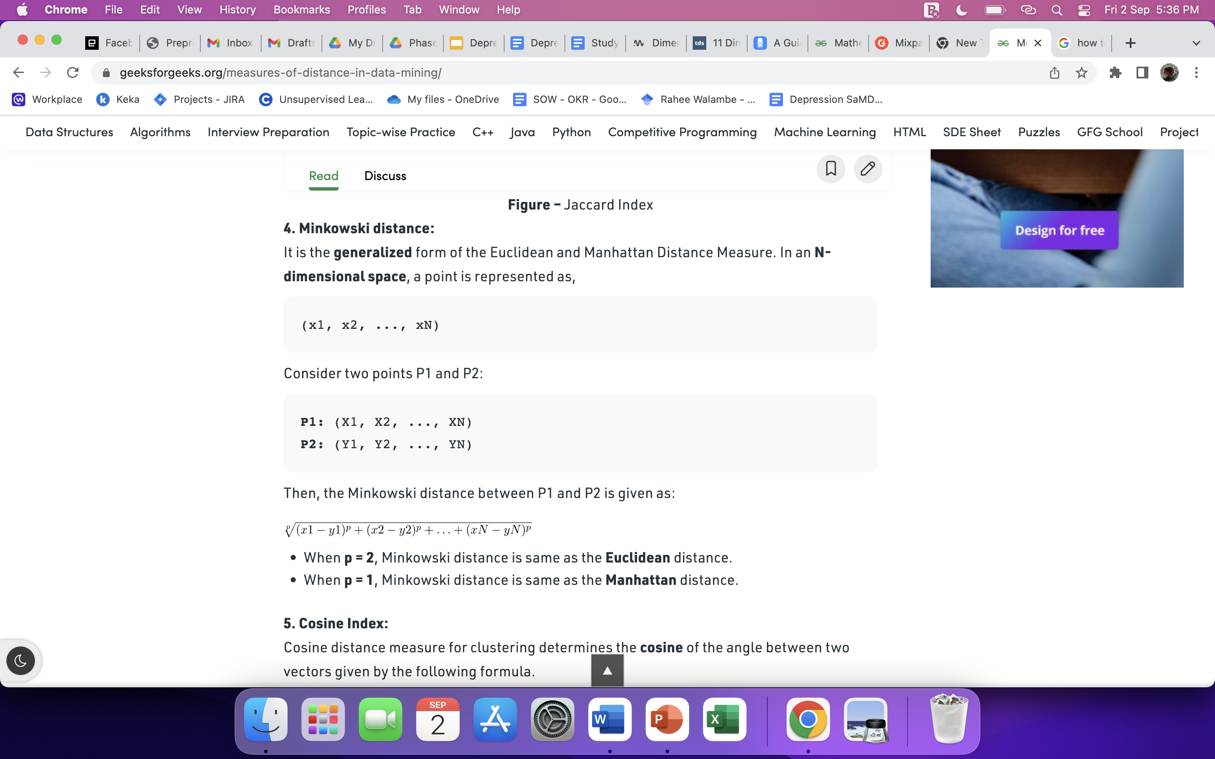
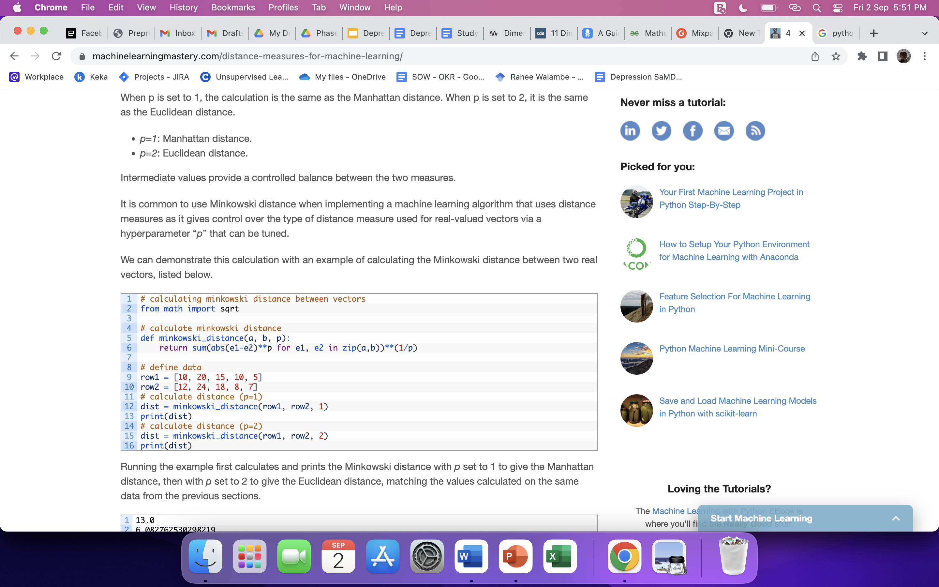
3. Minkowski distance: It is the generalized form of the Euclidean and Manhattan Distance Measure. In an N-dimensional space, a point is represented as,
(x1, x2, ..., xN)
Consider two points P1 and P2:
P1: (X1, X2, ..., XN)
P2: (Y1, Y2, ..., YN)
Then, the Minkowski distance between P1 and P2 is given as:
When p = 2, Minkowski distance is same as the Euclidean distance.
When p = 1, Minkowski distance is same as the Manhattan distance.
P = 1; 13.0
P= 2; 6.082762530298219

Slide 47
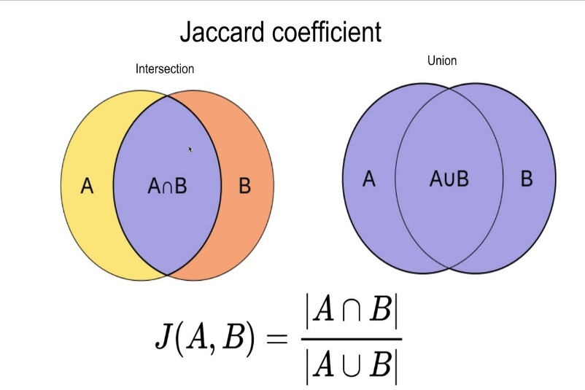
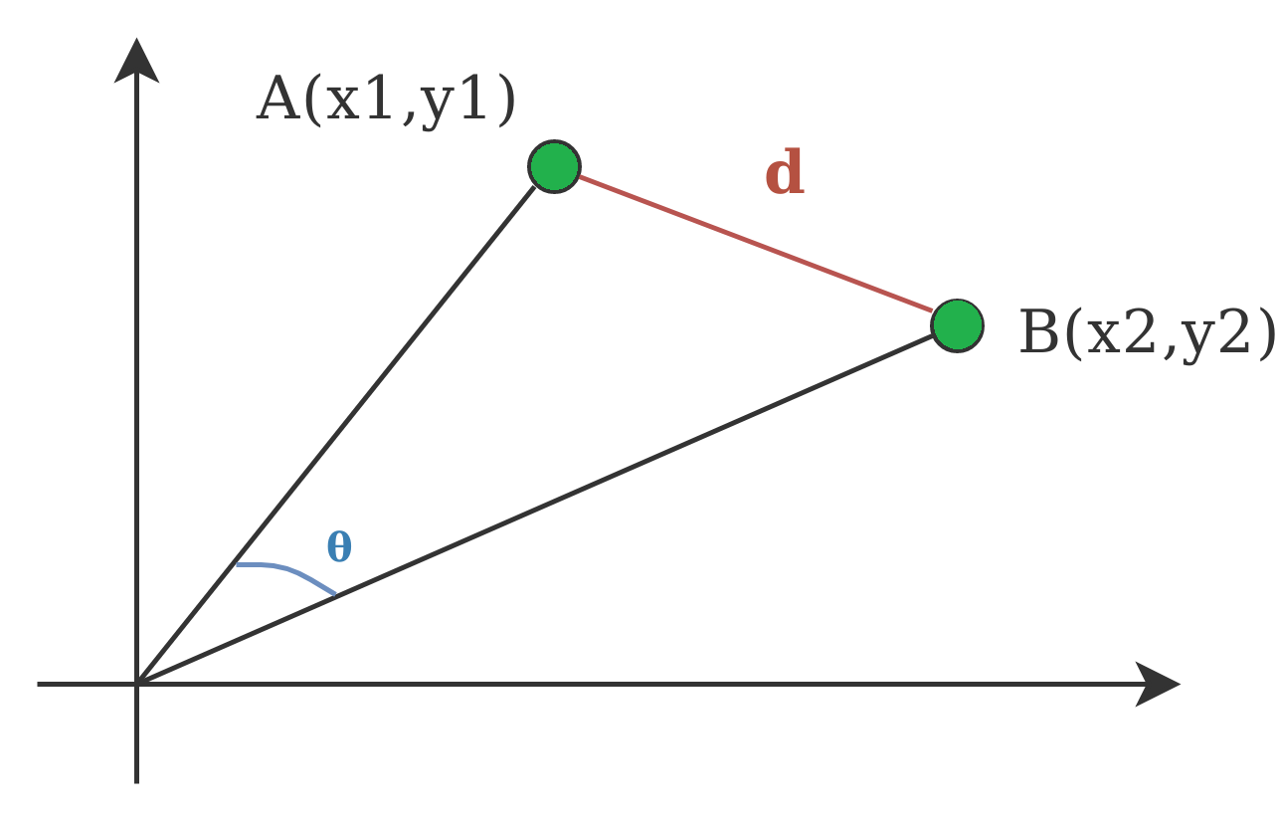
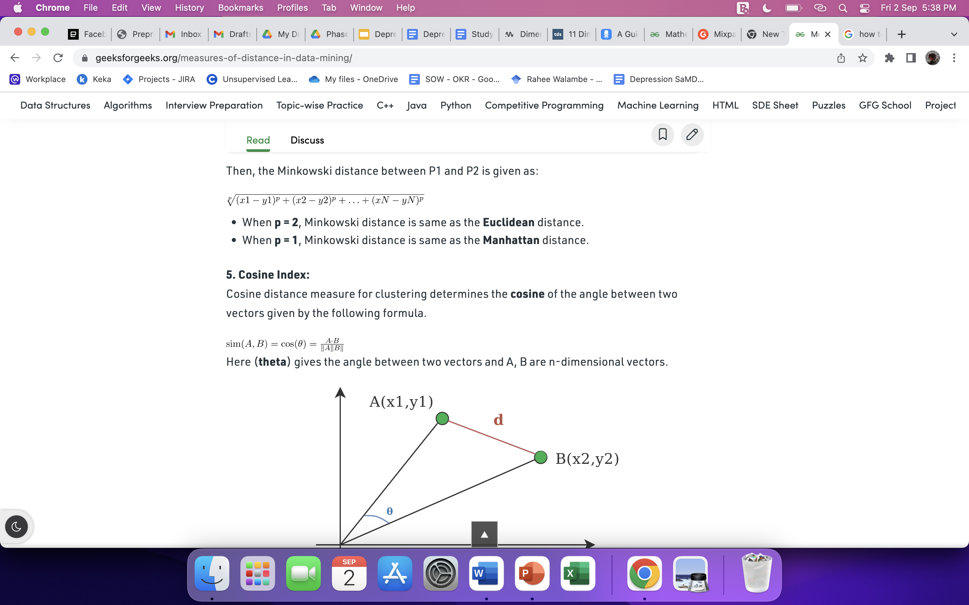
4. Jaccard Index: The Jaccard distance measures the similarity of the two data set items as the intersection of those items divided by the union of the data items.
5. Cosine Index: Cosine distance measure for clustering determines the cosine of the angle between two vectors given by the following formula.
Here (theta) gives the angle between two vectors and A, B are n-dimensional vectors.

Slide 48
Hamming Distance
Hamming distance calculates the distance between two binary vectors, also referred to as binary strings or bitstrings for short.
You are most likely going to encounter bitstrings when you one-hot encode categorical columns of data.
For example, if a column had the categories ‘red,’ ‘green,’ and ‘blue,’ you might one hot encode each example as a bitstring with one bit for each column.
red = [1, 0, 0]
green = [0, 1, 0]
blue = [0, 0, 1]
The distance between red and green could be calculated as the sum or the average number of bit differences between the two bitstrings. This is the Hamming distance.
For a one-hot encoded string, it might make more sense to summarize to the sum of the bit differences between the strings, which will always be a 0 or 1.
HammingDistance = sum for i to N abs(v1[i] – v2[i])
For bitstrings that may have many 1 bits, it is more common to calculate the average number of bit differences to give a hamming distance score between 0 (identical) and 1 (all different).
HammingDistance = (sum for i to N abs(v1[i] – v2[i])) / N

Slide 49
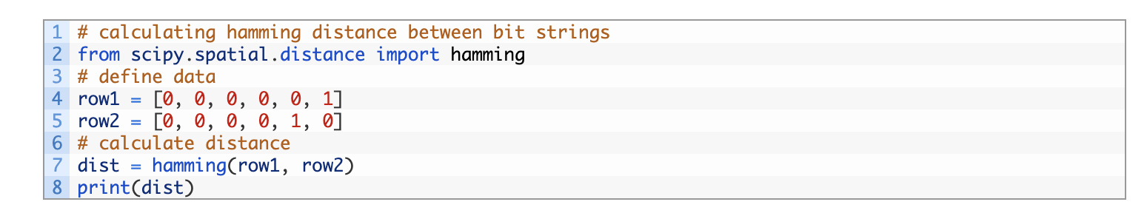
Answer : 0.333

Slide 50
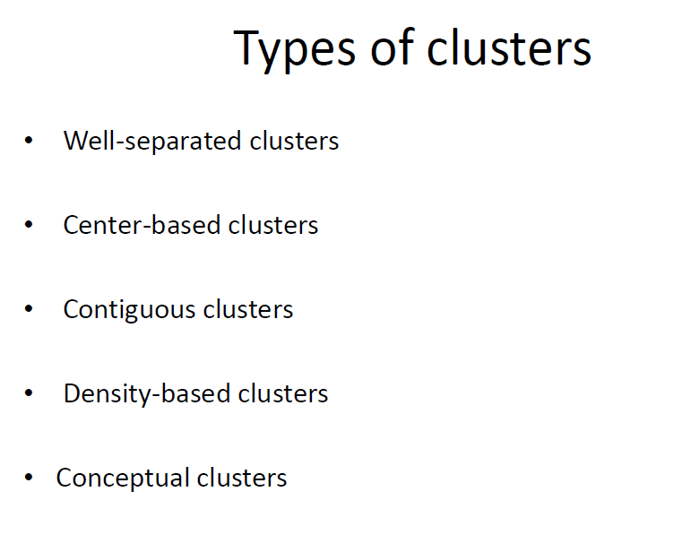

Slide 51
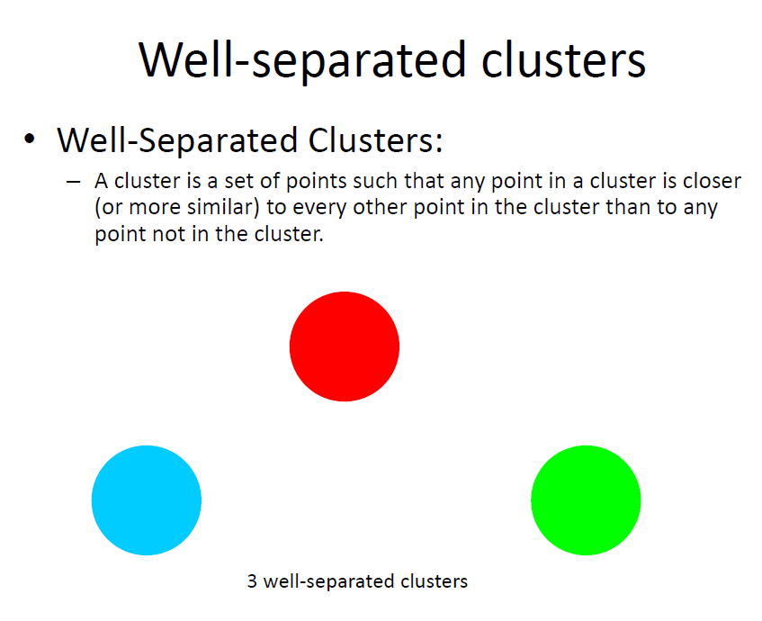

Slide 52
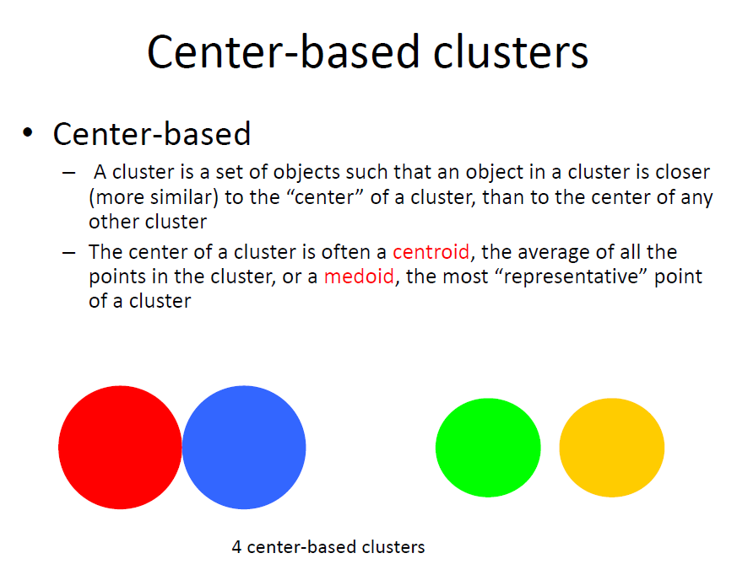

Slide 53
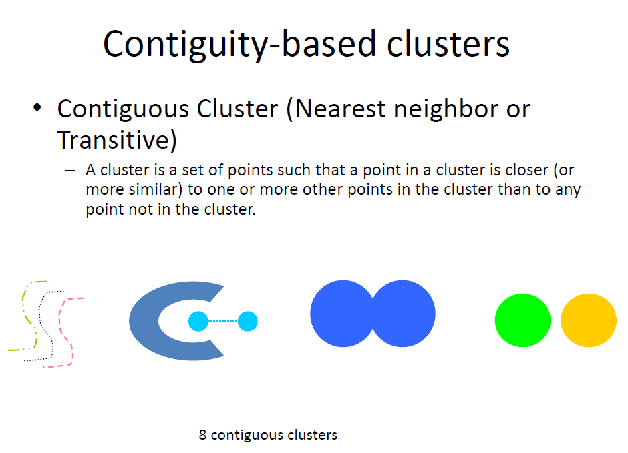

Slide 54
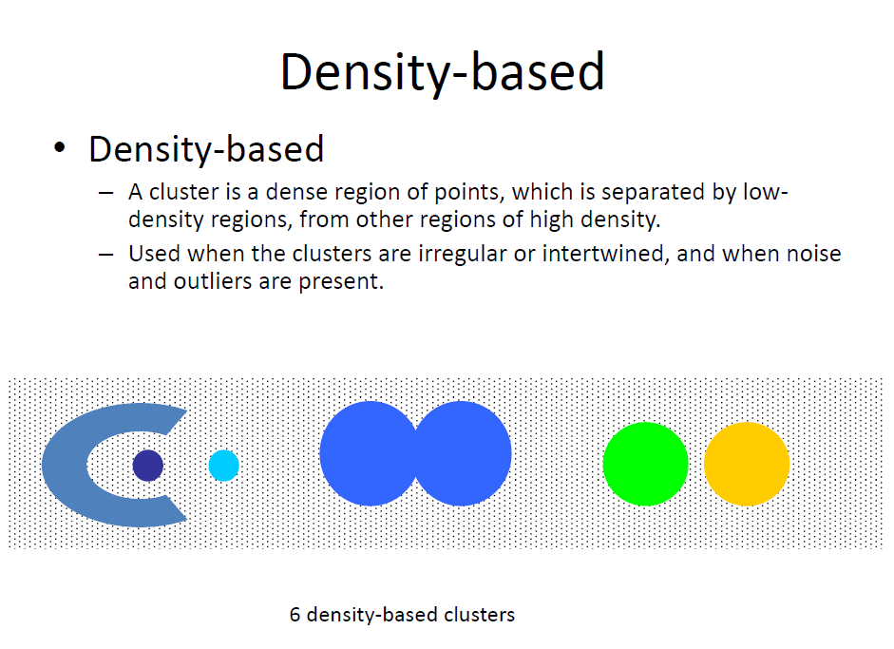

Slide 55
